Slide 1
Build Deep Learning Environment on CentOS 7
with GeForce GTX TITAN X from NVIDIA

Slide 2
Install NVIDIA’s Drivers-Prepare Machine
Before start, make sure login as root user
Update system and install requirement
yum -y update
yum –y upgrade yum -y groupinstall "GNOME Desktop" "Development Tools" yum -y install kernel-devel

Slide 3
Install NVIDIA’s Drivers-Prepare Machine
In order to have the NVIDIA drivers rebuilt automatically with future kernel updates you can also install the EPEL repository and the DKMS package. This is optional.
yum -y install epel-release yum -y install dkms
Reboot machine to make sure you are running the newest kernel

Slide 4
Install NVIDIA’s Drivers-Prepare Environment
Update grub configuration for X display
Edit /etc/default/grub. Append the following to “GRUB_CMDLINE_LINUX”
rd.driver.blacklist=nouveau nouveau.modeset=0
Generate a new grub configuration to include the above changes.
grub2-mkconfig -o /boot/grub2/grub.cfg
Edit/create /etc/modprobe.d/blacklist.conf and append:
blacklist nouveau
Backup your old initramfs and then build a new one
mv /boot/initramfs-$(uname -r).img /boot/initramfs-$(uname -r)-nouveau.img
dracut /boot/initramfs-$(uname -r).img $(uname -r)
Reboot machine to disable X display

Slide 5
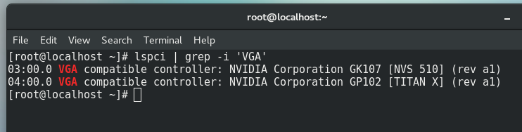
Install NVIDIA’s Drivers
Check the model of your GPU Card:
lspci | grep -i 'VGA’
Download the latest NVIDIA driver for Linux
https://www.geforce.com/drivers
The NVIDIA installer will not run while X is running so switch to text mode:
systemctl isolate multi-user.target
Run the NVIDIA driver installer and enter yes to all options.
sh NVIDIA-Linux-x86_64-*.run

Slide 6
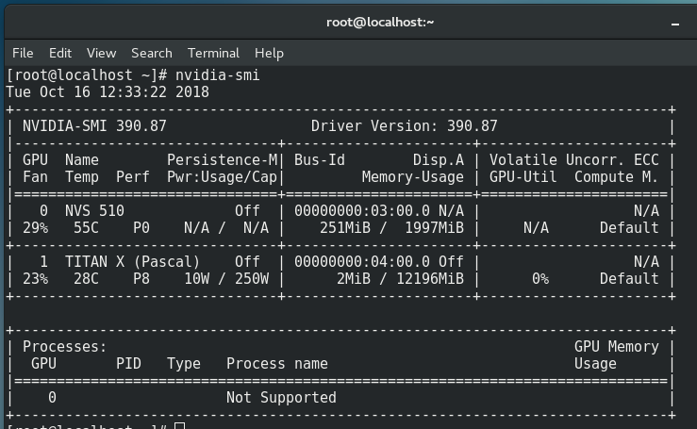
Install NVIDIA’s Drivers
Now you can check your GPU status via
nvidia-smi

Slide 7
Install NVIDIA’s CUDA Toolkit
Download the latest CUDA Toolkit
https://developer.nvidia.com/cuda-toolkit-archive
==> Linux ==> x86_64 ==> RHEL/CentOS ==> 7 ==> runfile (local)
Run the CUDA installer.
sh cuda_*.run
Say no to installing the NVIDIA driver, since it has been done.
To add CUDA to your environment, add the following files.
Create /etc/profile.d/cuda.sh
PATH=$PATH:/usr/local/cuda/bin
export PATH
Create /etc/profile.d/cuda.csh
set path = ( $path /usr/local/cuda/bin )
Create /etc/ld.so.conf.d/cuda.conf
/usr/local/cuda/lib64

Slide 8
Install NVIDIA CUDA® Deep Neural Network library (cuDNN)
Register and login on
https://developer.nvidia.com/cudnn
Download corresponding cuDNN matching your installed CUDA version
Following is the official instruction for cuDNN installation
https://docs.nvidia.com/deeplearning/sdk/cudnn-install/index.html

Slide 9
Install NVIDIA Collective Communications Library (NCCL) - Optional
Register and login
https://developer.nvidia.com/nccl
Download corresponding NCCL matching your installed CUDA version
Following is the official instruction for cuDNN installation
https://docs.nvidia.com/deeplearning/sdk/nccl-install-guide/index.html

Slide 10
Install Python3-System Preparation
Install necessary tools and utilities
yum update
yum install yum-utils
yum groupinstall development

Slide 11
Install Python3-download and install Python
Install an IUM repository, (Inline with Upstream Stable), which provides the necessary RPM packages.
yum install https://centos7.iuscommunity.org/ius-release.rpm
yum install python36u
Then we can check the installed Python version
python3.6 -V

Slide 12
Install Python3-install pip for Python
Following commands are installing pip to manage Python packages,
and some development packages
yum install python36u-pip
yum install python36u-devel

Slide 13
Creating a virtual environment for project
The preferred way to create a new virtual environment in Python 3 is to run (in your project directory):
python3.6 -m venv myvenv
where the former venv is the command to create a virtualenv, and the latter myvenv is the name of the virtual environment.

Slide 14
Virtual environment activation
To activate your created environment
. myvenv/bin/activate
To deactivate your current environment
deactivate

Slide 15
Install TensorFlow and TensorFlow-GPU
Install Tensorflow and Tensorflow-gpu via pip in your project environment
pip install tensorflow==1.3(or other specific version)
Without version number will install latest version
pip install tensorflow-gpu==1.3(or other specific version)
Without version number will install latest version

Slide 16
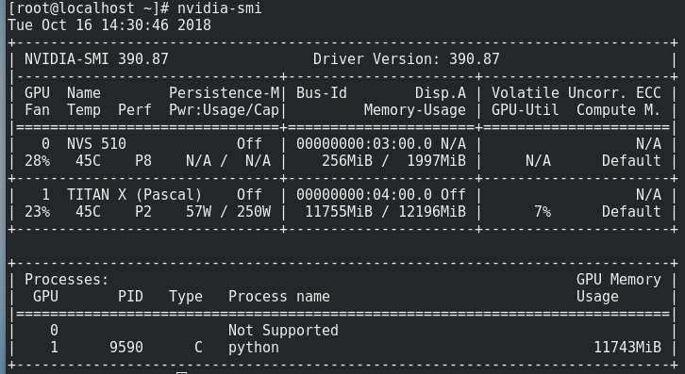
Testing-comparing GPU and CPU
Download and run the code for Single GPU test from
https://gist.github.com/j-min/baae1aa56e861cab9831b3722755ae6d
The task is shown in GPU status via
nvidia-smi

Slide 17
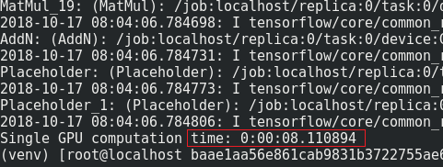
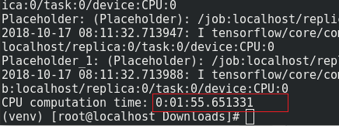
Testing-comparing GPU and CPU
Update the code to using CPU, and run it again.
then comparing the running time
GPU: 8 seconds CPU: 116 seconds

